Slide 1
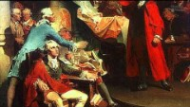
European Culture Contributions to Government

